Slide 1
Development of touch type Electric Gayageum for an experience-oriented exhibition
Team 9
Kyungpook National University – Computer Science and Engineering
2013105067 Lee Gyu Dong (leader)
2013105030 Gim Han Yeong
2011097084 Han Jae Hyun
Kumoh National Institute of Technolongy – Computer Science
20160437 Ma Jui
20160168 Kim Myeong Ji

Slide 2
Project Background and Purpose
Classical music instrument
Expensive
Difficult
Public Recognition
Change
To get close to the public.
Especially to be familiar with children.
Electronic Korean Instrument

Slide 3
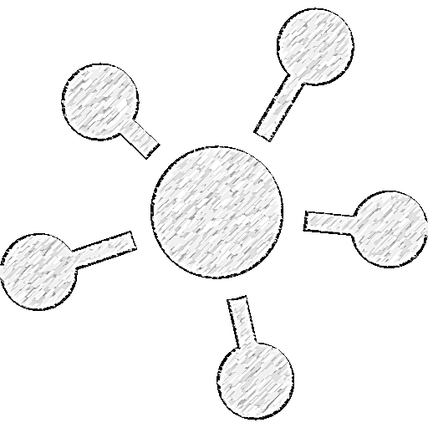
Project differentiation
Data of education
Using Arduino
Touch sensor & Pressure sensor
Real gayageum sound
Automatical LED light score

Slide 4

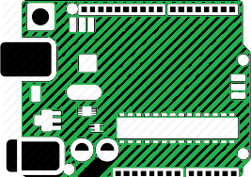

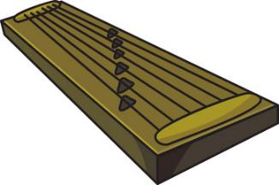
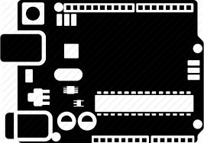

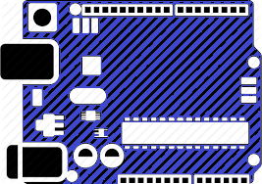
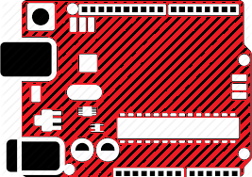
System Block Diagram
output
input
Touch module
Arduino
UNO
Arduino
Pro micro
DF player

Slide 5

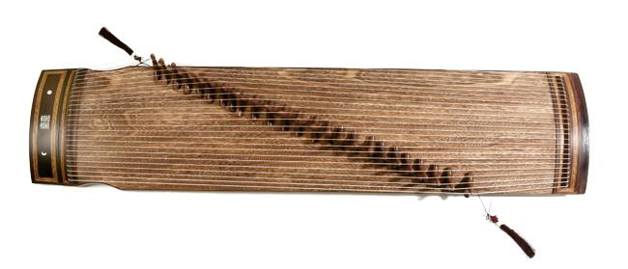
System Block Diagram
MAKE SOUND
TUNE UP

Slide 6
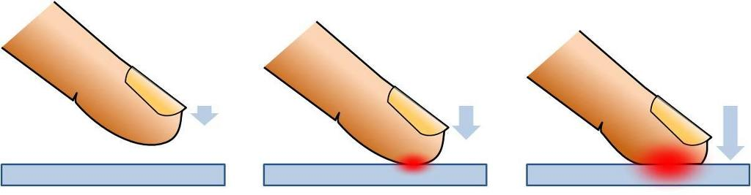

System Block Diagram
Pressure Sensor
TUNE UP

Slide 7
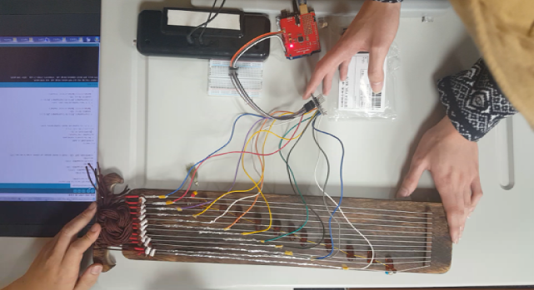
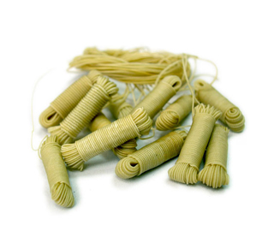
Problems
Need storage space
Need to change with
Electrically conductive object

Slide 8
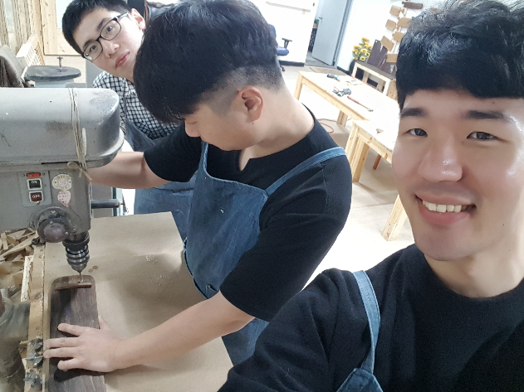
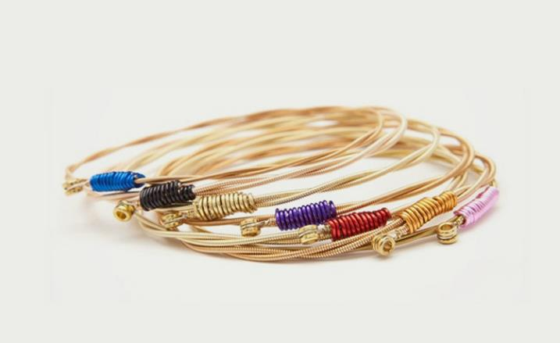
Solution
Make space
Change with guitar string

Slide 9
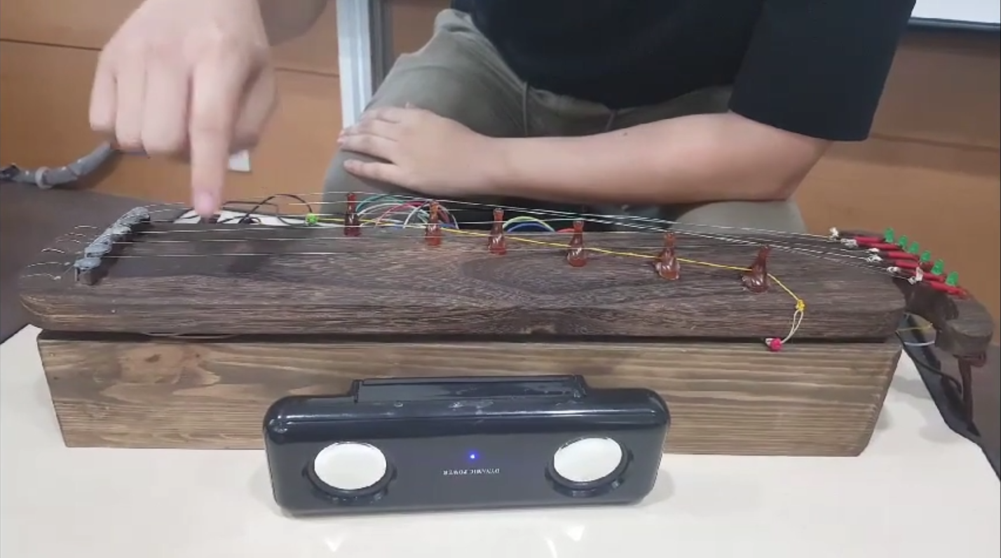
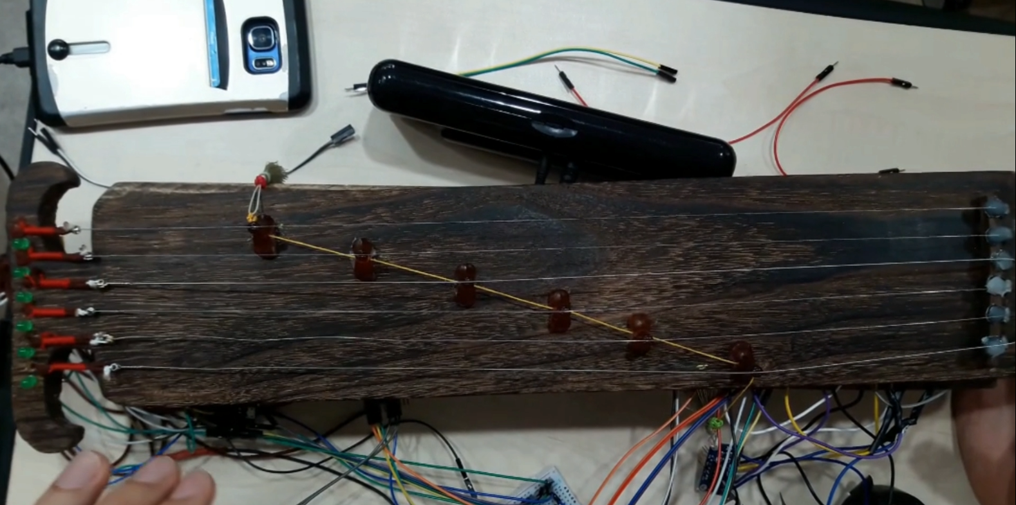
Demonstration
https://youtu.be/wMG0Jv-cBLs
Contents
Using Pressure Sensor

Slide 10


Point of improvement
Delay Buffer
Without
Multi sound

Slide 11
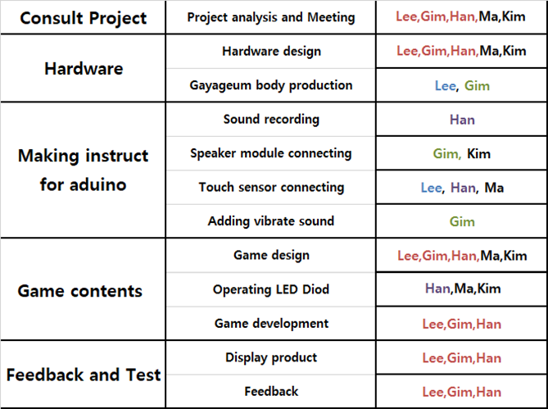
Project Distributing Roles

Slide 12
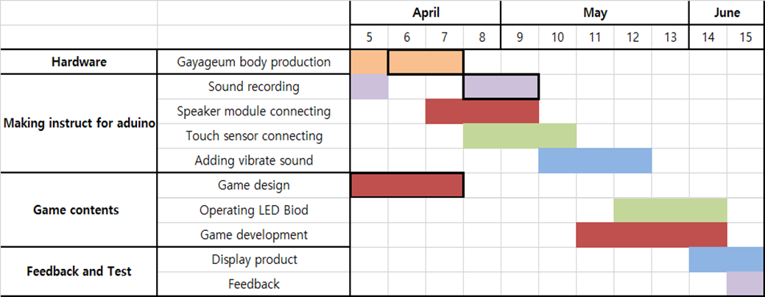
Project Schedule

Slide 13
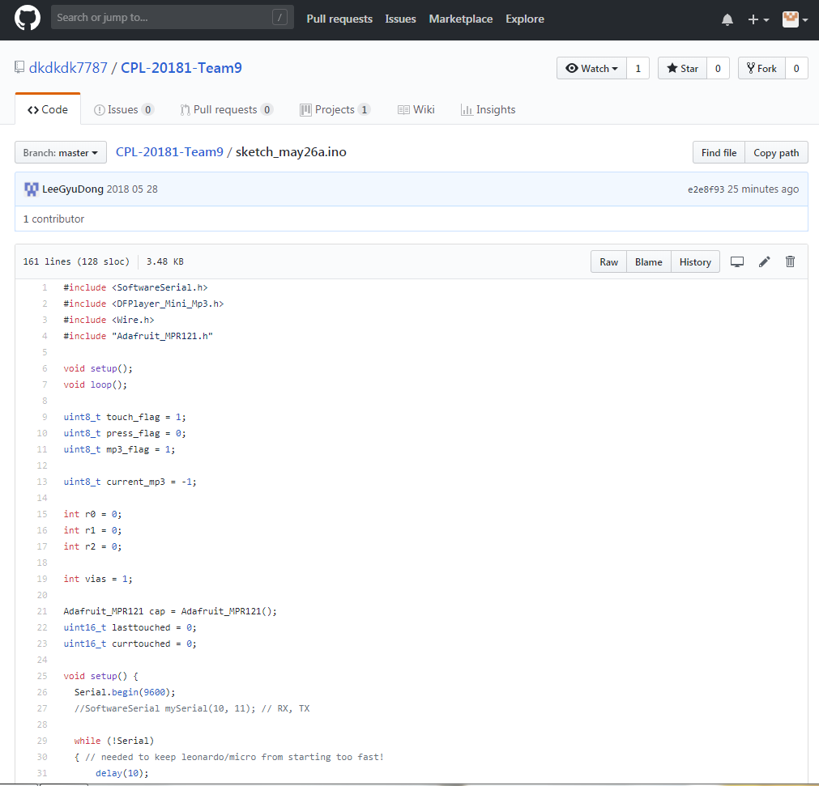
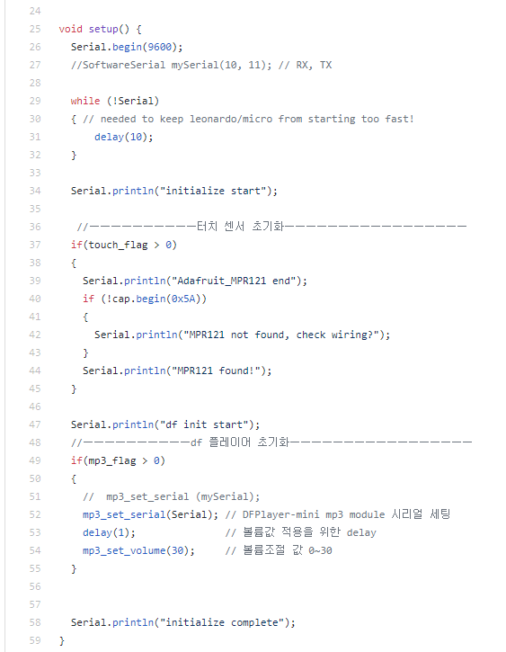
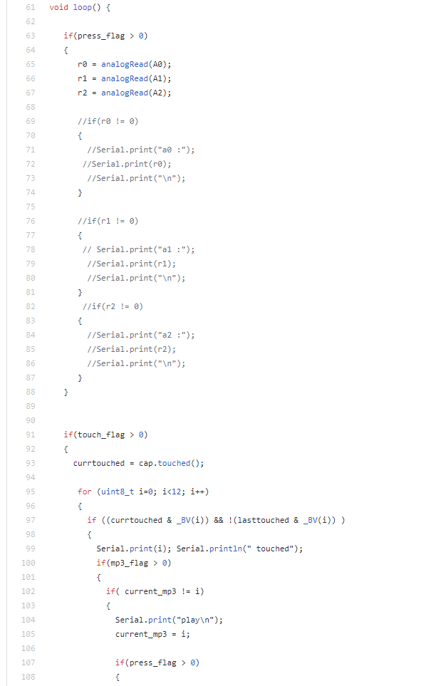

Slide 14
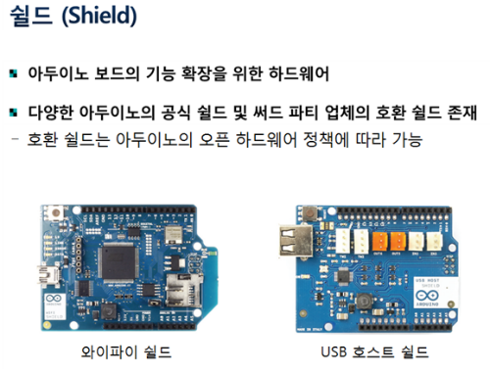
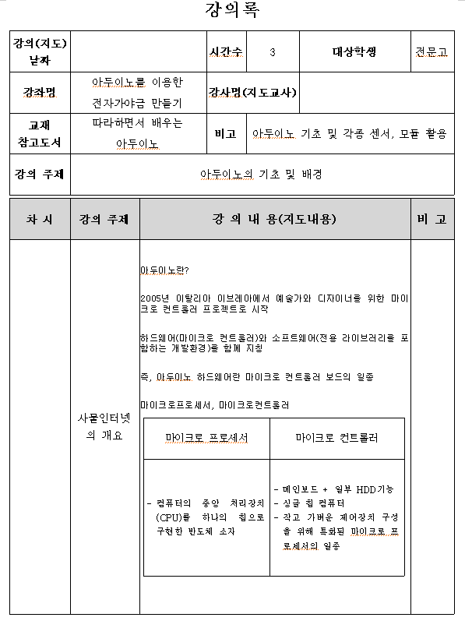
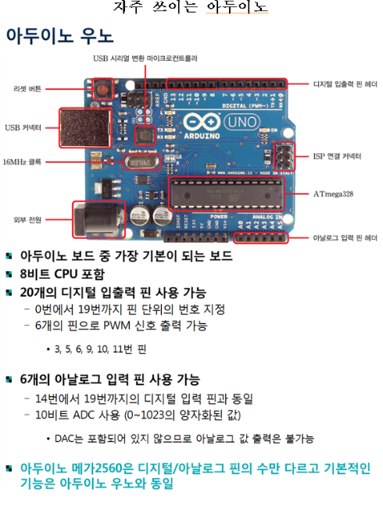
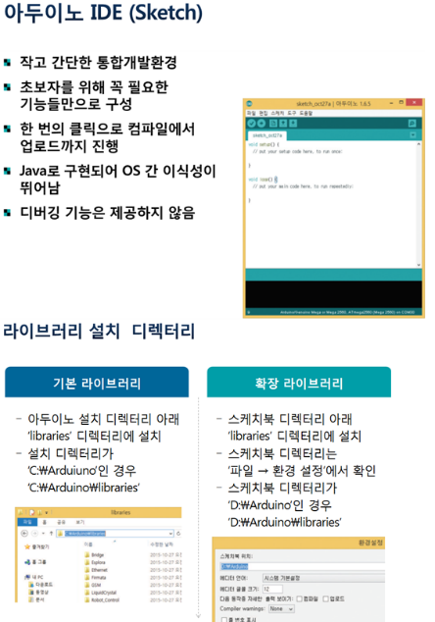
Data of education

Slide 15
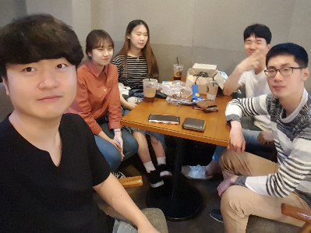
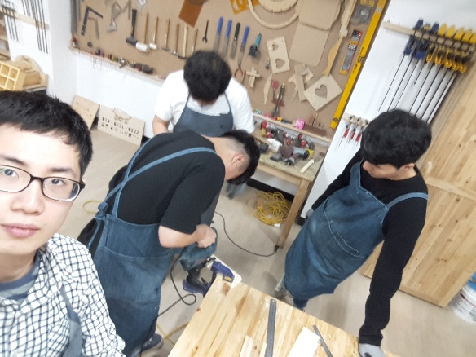
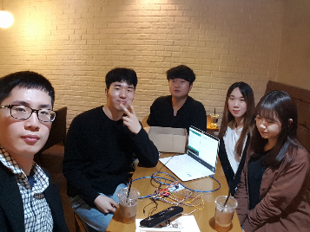
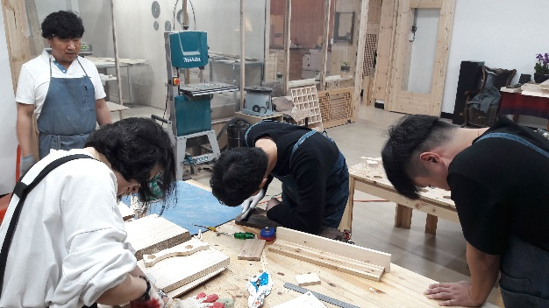
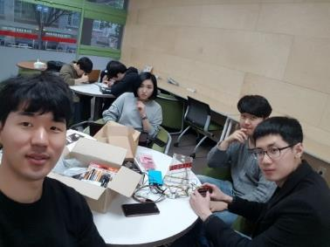
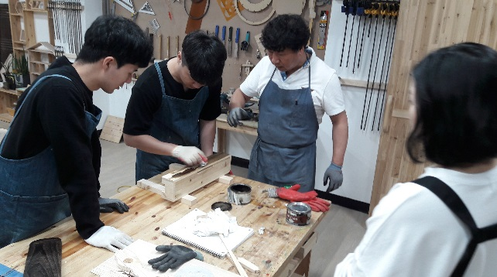

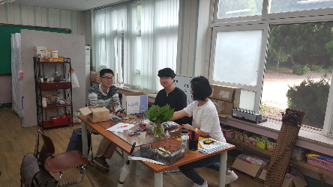
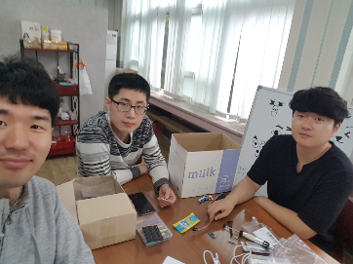
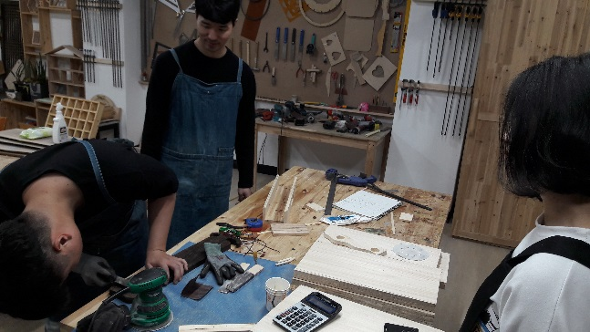
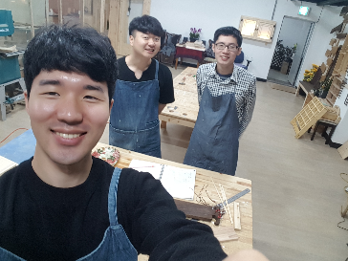
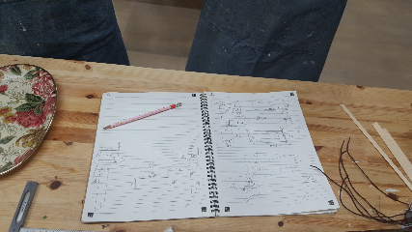
Meeting

Slide 16
Q&A
Thanks.

